Slide 1
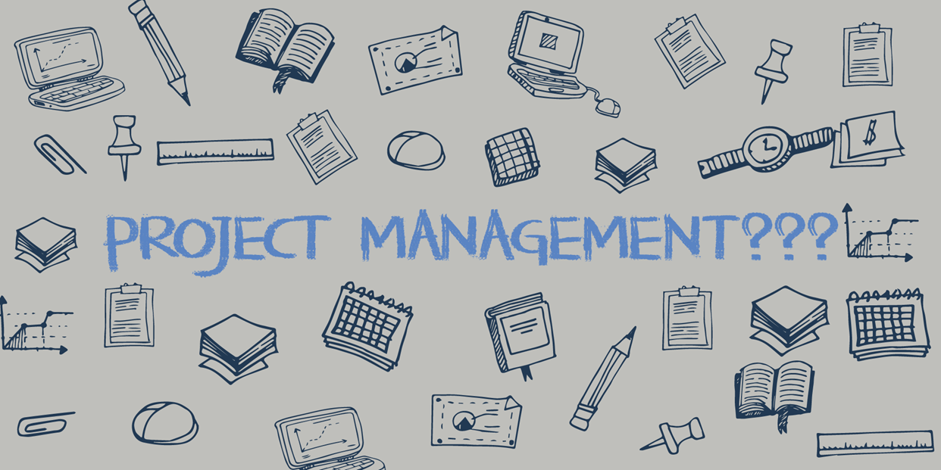

Slide 2

Introduction ’s

Slide 3

Any Project Management Experience?
Expectations of the session:

Slide 4

Project Management
Objectives:
At the end of this short class you will be able to:
Define what Project Management is
Understand what the “Scope” of a project is.
Identify Stakeholders.
Identify Critical Path Analysis.

Slide 5
Course Objectives
Gain basic information needed to be effective project team members.
Gain a broad understanding of the project management life cycle.
Gain an understanding of select project management practices.
Learn tools and techniques for immediate application.
Learn a standard vocabulary for project management.
Understand where to get more information and help.

Slide 6
What is Project Management (PM)?
Project management is about execution.
Getting it done.
Making it happen.
You can have a great idea, but if you can't implement it, it doesn't matter.
It's about making a difference.

Slide 7
Project management is about seeing the future.
It's about having a vision and creating a path to get there.
It's about strategy.
Project management is about being prepared.
It's about managing risks proactively and handling issues decisively.
It's about finding opportunities when issues arise.

Slide 8
Project management is about doing it right the first time.
It's about deciding HOW you're going to do it.
It's about deciding WHAT you're going to do...
...And what you're NOT going to do.
It's about planning and re-planning.

Slide 9
Project management is about being prepared.
It's about managing risks proactively and handling issues decisively.
It's about finding opportunities when issues arise.

Slide 10
Project management is about building a team.
It's about developing relationships.
It's about motivating and recognizing people.
It's about celebrating together.
It's about leadership

Slide 11
Project management is about making a plan come together.
It's about bringing order to the chaos.
It's about getting everyone pointed in the right direction.
It's about action and achievement.

Slide 12
In a world of faster, better, cheaper...
Project management brings the discipline to the table that makes the impossible possible.
Discipline brings consistency, repeatability, and visibility.
It's about learning from each project so that the next one is even faster, better, and more profitable.

Slide 13
Project Management Institute (PMI)
Oh, and in case you were looking for a formal definition of project management, here's what the Project Management Institute (PMI) has to say about it...
"Project management is the application of knowledge, skills, tools, and techniques to project activities to meet the project requirements.“
- PMBOK

Slide 14
Knowledge Areas that we will cover
Framework for Project Management
Scope Management
Time Management
Risk Management
Comms Management

Slide 15
Exercise
Discuss the below three topics:
What is a project?
What are the common activities that Project Managers perform
What are some of the reasons that projects fail

Slide 16

What is a project?
Temporary
Specific start and end date
Unique
Results in a new or revised end product/service
Progressively Elaborated
Broadly defined initially and then more explicitly defined as work progresses

Slide 17
Project Management Activities
 | Typical PM Activities
√ | Help identify requirements
√ | Establish clear and achievable goals
√ | Balance competing demands for quality, scope, time and cost
√ | Manage risks to project objectives
√ | Stakeholders Management
√ | Communication
√ | Proactively exercise project control
MANDATORY FOR ALL PROJECTS

Slide 18
Why Projects Fail?
Level One
Inappropriate Project Management Approach |  | Unsupportive Top Management
Level Two
Wrong Project Manager | Failure to use Methodology |  | Misuse of Project Management Techniques
Level Three
Inadequate Communication | Non-involvement of the user |  | Inadequate planning
Inadequate definition | Bad estimating |  | Incorrect scheduling / resources
Numerous changes | Inadequate control |  | Poorly planned rollout
Source: John Nicolas

Slide 19
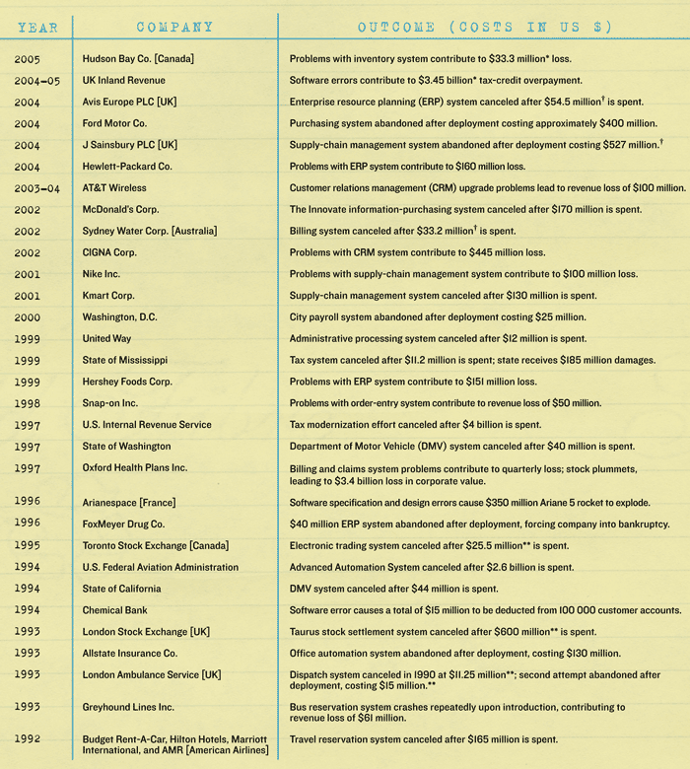

Past project failures
2002 – MacDonalds: purchasing system cancelled after costing $170m
2004-95 - UK Inland Revenue: Software errors contribute to $3.45bn tax credit overpayment
2004 – Sainsbury: Supply chain system abandoned after costing $527m
2005 - Hudson Bay Co (Canada) problems with Inventory systems contribute to $33.3million loss
1997– US Internal Revenue tax modernization is cancelled after costing $4bn
1993– London Stock Exchange Taurus stock settlement system cancelled after $600m
Notes:
Irish examples ? Water Meters ? Electronic Voting machines ?

Slide 20
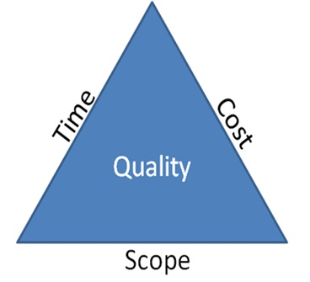
The Triple? Constraint
Risk
One side of the triangle cannot be changed without affecting the others.

Slide 21
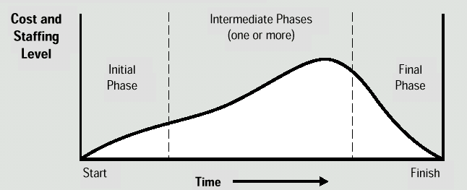
Cost and Resource Curve

Slide 22
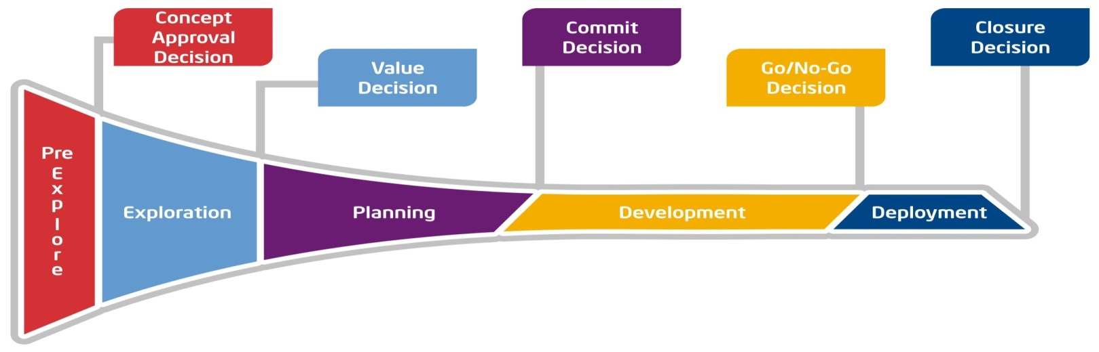
Program/Project Life Cycle (PLC)
The PLC is a framework of controls that provides a minimum set of information to ensure program and projects:
Align to business objectives
Launch only when they are ready
Stay healthy throughout their lifecycle
Deliver the intended capability

Slide 23
Initiation
Conclusion
Software Project Life Cycle
Systems
Analysis
Design
Coding
Build
Release
requirements specification
design specification
or
prototype
source
code
compiled code &
libraries
help files
packaging
media

Slide 24
Phase & Outputs
Phase | Major Output | Gating Decision
Pre-Explore | Charter Document | Concept Approval
Explore | Initial Project Management Plan | Value Approval
Planning | Detailed Project Management Plan | Commit Approval
Development | Execution/ Deliverables/ Tracking | Go/No Go Approval
Deployment | Product/ Service/ Process Implementation | Closure Approval
Closure | Post Implementation Review | - - - - - -

Slide 25
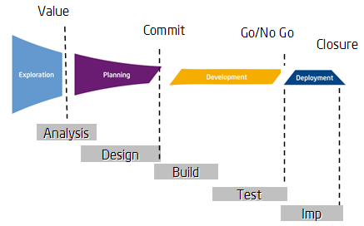
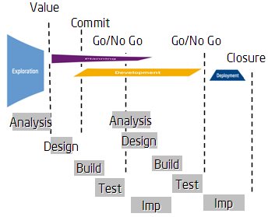
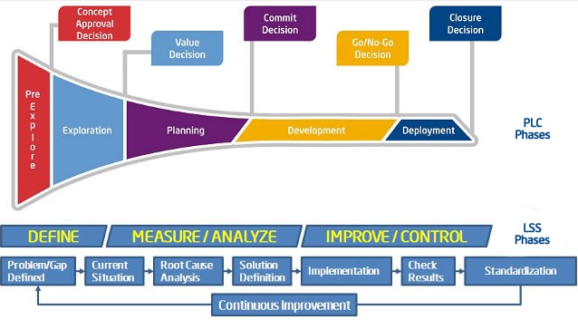
Methodologies
Job Aid
Phase | Value or Benefit | Gating Decision
Waterfall | Projects where requirements are known up front and are stable and for projects with a single release.
SCRUM / XP (Agile) | Satisfy customers through early and continuous delivery of working features. Allows projects to adapt to frequent requirement changes more quickly and emphasizes continual stakeholder involvement.
Lean Six Sigma | Helps continuously improve our performance to customer expectations. Integrating LSS compliments a projects methodology for improved quality assurance to a project's targeted end product and/or service.

Slide 26
Module 2: Scope Management
Phase 1: Pre-Explore

Slide 27
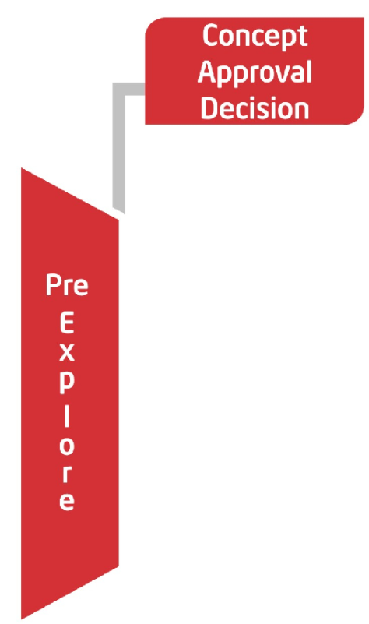
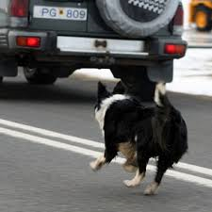
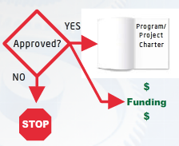

Slide 28


What is a Project Charter
“ A document issued by the project initiator or sponsor that formally authorizes the existence of a project, and provides the project manager with the authority to apply organizational resources to project activities”
PMBOK® Guide

Slide 29
Project Charter Content
Dependencies
Assumptions / Risks
High-Level Schedule
Resources / Budget
Critical Success Indicators
Boundary Conditions
PM Authority
Key Stakeholders
Problem or Opportunity and Vision
Alignment with Strategic Priorities
Business Transformation
Scope - Mandatory
Key Features / Requirements
Solution Alternatives

Slide 30
Makey Up Project Charter
Project Name: |  |  | *** Standardisation
Department: |  |  | My Old Department
Facilitator:
Name: James Kearney |  |  |  | Role: Facilitator | Mobile:0876148378 | Extn:
Champion:
Name: James Kearney's Boss |  |  |  | Role: Coach/Team Leader | Mobile: | Extn:
1 | Timelines
 | Start date |  | 18/05/2018 | Finish Date | 20/06/2018
 | Start time |  | 8am | Finish time | 5pm
2 | Problem Statement
 | For **** , F24 takes longer than F32 from start to first monitor results. The PM is not standardised across the 4 shifts.

Slide 31
2.1 | Objectives
 | Educate team on Lean/HPM Tools and methodologies
 | Standardise PM across all shifts with improvements agreed
 | Agree Work changes
 | Have training plan agreed to roll out to all shifts
2.2 | Out of Scope
 | Reducing the PM time , working on similar PMs
2.3 | Customers
 | F24 /F32/Managers A,B,C
2.4 | Mapping Definition
3 | ARs ( Defined at Prep Meeting)
# | Item |  |  | Status | ECD | Comment
3.1 | Book Kaizen room, organise all materials for event |  |  | Open |  | JK
3.2 | Assemble Team - 4 from across the shifts |  |  | Open |  | JK
4 | Team
 | Name: |  | Role | Mobile: | Extn:
 | Engineer |  | Leader
 | Manager |  | Coach
 | Tech1 ShA |  | Tech
 | Tech2 ShB |  | Tech
 | Tech3 ShC |  | Tech
 | Tech4 ShD |  | Tech
 | James Kearney |  | Facilitator

Slide 32
Scope/ Assumptions/ Dependencies
Scope
The main purpose of scope definition is to clearly describe the boundaries of your project at a high level.
Scope consists of two elements – In Scope & Outside of Scope
Assumptions
Assumptions are considered to be true, real or certain without proof.
The project sponsor(s) should be aware of these before making a decision on funding the project.
Dependencies
List of any known interdependencies or links between your project and other programs, projects, capabilities, initiatives.

Slide 33
Stakeholder Management & Communication
Effective communication with key stakeholders is essential to the project’s success.
Manages stakeholder expectations through all project phases.
Encourages buy-in by managed involvement .
Improves co-operation and co-ordination.
Avoids unexpected intervention.
Timely & relevant communication is key to align perceptions with facts.
Note: other stakeholder mgmt tools exist on PM central.
This is an additional tool to help identify stakeholders

Slide 34
Question
All of the following must be performed during Pre-Explore phase except?
Identify and document business needs
Create a detailed project scope statement
Divide a large project into phases
Accumulate and evaluate historical information
Notes:
2

Slide 35
Module 2: Scope Management
Phase 2: Explore and Planning

Slide 36
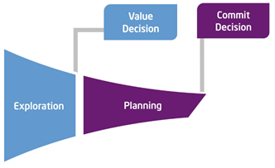
Explore & Planning
The purpose of these phases are to plan how the project will be executed, monitored & controlled, and closed.
The objective is to receive formal value & commit approval and prepare to move into the PLC Development Phase.
The Project Management Plan (PMP) is the output of this phase.

Slide 37
Project Management Plan (PMP)
The PMP is a document that contains project plan information.
The PM starts this in the Exploration Phase and flushes out the details in the Planning Phase.
Examples of information contained in the PMP:
Scope Management Plan
Time Management Plan
Communication Plan
Risk Management Plan
Quality Management Plan
After each significant change to the PMP and prior to the PLC Value decision, the project team and appropriate stakeholders should review the PMP.

Slide 38
Exercise
Brainstorm some of the actions required to create a project management plan (PMP) that is
bought into by team members
Approved by your sponsor
Realistic in terms of constraints
formally recognized in your teams portfolio
Notes:
Lots of answers are correct here:
Determine a methodology for your pmp
Agreed reporting formats/comms plans
Agreed processes to report, control and incorporate changes
Analyse stakeholder needs, wants expectations and assumptions
Capture requirements (project/product) as completely as possible
Analyse the skills, knowledge, influence of all stakeholders to determine how you will use them on the project
Defined roles on the project
Get buy in from resource managers
Ensure that you have the correct resources for the right amount of time
Give team members a chance to approve the final schedule and convert time estimations into a calendar schedule
Work through iterations of the plan (i.e. updated WBS after you conduct detailed risk analysis)
Create all necessary project documents
Apply risk reserves to project schedule and budget
Look for dependencies between your projects and other projects
Inform sponsor on the reality of their constraints that were outlined in the charter i.e. can they be met?
Perform schedule compression techniques and present options to the sponsor

Slide 39
Module 2: Scope Management
Phase 3: Scope Management Plan

Slide 40
Scope Management Plan
The Scope Mgmt Plan essentially covers three important topics on your project:
- How will scope be planned
- How will scope be executed
- How will scope be validated, controlled, and verified
The scope of your project is everything that you will do to deliver exactly what the customer wants, nothing more, nothing less. The scope is often split into project and product:
Product scope – everything required for the customer
Project Scope –everything the project team need to do to deliver the product

Slide 41

Requirements
Defines and documents stakeholders’ needs to meet the project objectives
Requirements define the characteristics and behaviour of the product or service to be provided.
Requirements are often broken down into Functional and Non-functional.
Occurs during PLC Exploration and Planning phases.
Techniques for gathering requirements can include interviews, focus groups, surveys, prototyping and observing users etc.
Cost, schedule and quality planning are built upon these requirements. Thus a change in requirements results in a potential change in these 3 vectors.

Slide 42
Requirements Exercise
You are a Project Manager who has been given the below opportunity statement by the head of HR – what are the key requirements?
“Assess the opportunity to eliminate the need for hardcopy paystub printing and postage costs across all of our companies, where legally permissible, through the deployment of a best in class , cost effective cloud based solution that can support Single Sign On. ”
Take some time to discuss both the process that you would go through to gather requirements and what they might look like

Slide 43
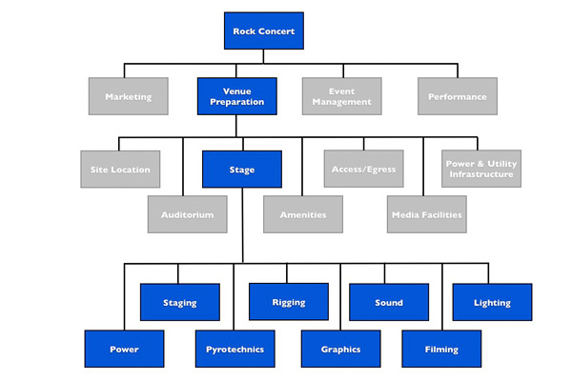
Work Breakdown Structure (WBS)
PMI PMBOK defines a WBS as …
“a deliverable-oriented hierarchical decomposition of the work to be executed by the project team, to accomplish the project objectives and create the required deliverables. The WBS defines the total scope of the project.”
Organizes and defines
Decomposition
Products, goals, deliverables and/or phases

Slide 44
Example WBS
Take the requirements you gathered from the last exercise and build an example WBS.
What does the Work-Break-Down (WBS) structure look like?
Take a few mins, draw a WBS, you can chose how it is structured – take it to 2 levels
Template

Slide 45
Control Scope
Now that you have your WBS and a general understanding of the totality of your project – your responsibility as a project manager turns to ensuring you can control your scope:
What is involved in controlling your scope?
Measuring progress as agreed with the customer
Assess, monitor and control any changes to originally agreed requirements
Assess, monitor and control any known/unknown risks or quality incidents
How? Start and maintain a RAID log
Notes:
Risks: Events that will have a negative impact on your project if they occur. Risk refers to the combined likelihood the event will occur and the impact on the project if it does occur
Assumptions: Any factors that you are assuming to be in place that will contribute to the successful result of your project. The log includes details of the assumption, the reason it is assumed and the action needed to confirm whether the assumption is valid.
Issues: Something that is going wrong on your project and needs to be managed. Failure to manage issues may result in a poor delivery or even failure. The log includes a description of each issue, the impact it is having, its seriousness and actions needed to contain and remove it.
Dependencies: Any event or work that are either dependent on the result of your project, or your project will depend on. The log captures who you are dependent on, what they should deliver and when. It may also include who is dependent on you.

Slide 46
Question
A Project is 95% complete. All but one of the scheduled quality inspections have been completed and all have met the desired level of quality.
All items in the project RAID log have been closed. This has been a huge effort by the team as the project has had a significant number of challenges along the way , predominantly caused by frequent scope change requests by the customer.
The sponsor has scheduled the final product acceptance call. Almost immediately the customer calls you to request a major scope change.
What should the PM do?
Notes:
Common responses to this scenario are:
Meet with the project team to determine if this change can be made
Ask the customer for a detailed description of the change
Say no too late
Inform the sponsor
The correct answer here for the PM is 2 – get a detailed description of the change so that they can understand the impact of the change. The role of the PM is to bring order, clarity and information to senior managers for the sole purpose of informed decision making. Impact of change should be quantified in terms of cost, time, risk, quality, scope.

Slide 47
Question
Which of the following is most correct in regard to controlling scope:
Effective scope definition can lead to a more complete project scope statement
The control scope process must be done before scope planning
The control scope process must be integrated with all other project processes
Controlling the schedule is the most effective way of controlling scope
Notes:
3 - The control scope process must be integrated with all other project processes
Though it is correct that effective scope definition can lead to a more complete project scope statement, this cannot be the answer, because it does not deal with control. Scope planning happens before you begin to control the scope not after it. Controlling the schedule is not the best way to control scope. Scope control does not act in isolation – remember the triple constraint – a change to one is more than likely going to impact the others – therefore the need to integrate the scope process with other processes is the best answer.

Slide 48
Time Management Plan
Time Management plan requires Project Managers to think about the below in detail before any scheduling occurs:
- What methodology/ software will be used
- Rules for estimations
- How will the schedule be measured / controlled?
- How will variances / changes be managed
- How will I report progress throughout the schedule?
Key output of Time Management Plan
The creation of a realistic and approved project schedule.

Slide 49

Creating a Project Schedule
Key explore & planning stage deliverable
For any project need to define:
What the project will deliver
Which resources will do what
When deliverables will be completed
Many approaches & techniques e.g.
Work breakdown structure
Project flow
MAP day
Critical path analysis
Agile: Planning game
Job Aid

Slide 50
Creating a Project Schedule Cont
You have your tasks identified and aligned in your WBS – how do you now create a schedule that is realistic and can be approved by all stakeholders?
Identify sequence and dependencies
Add task estimates
Prepare the schedule
Identify critical path
Assign & level resources

Slide 51
Sequence Activities
We take the activities and order them in the sequence that work will be performed
Result – Networked Diagram e.g.
B
Start
A
D
End
C
Types of relationships – 3 main ones:
Finish to Start (FS)
Start to Start (SS)
Finish to Finish (FF)
A
A
A
B
B
B

Slide 52
Create a Network diagram
Activity 1 can start immediately
Activity 2 can start after activity 1 is completed
Activity 3 can start after activity 1 is completed
Activity 4 can start after activity 2 is completed
Activity 5 can start after activity 4 is completed and after activity 3 completed

Slide 53
Sequence Activities
2
4
Start
1
5
End
3

Slide 54
Task estimations
All activities that are part of the WBS should be estimated – this is then combined to form the total amount of time required for the Project
The estimations should be provided by the people who do the work where possible.
How is estimating done?
1 point estimates – 1 person makes 1 recommendation on duration – least reliable
Analogous estimates – estimates taken from similar projects done previously – uses expert judgement, historical information and is very common.
3 point estimations (PERT) – State estimates in a range – Optimistic, Most likely and Pessimistic . Helps plan for potential variations and is weighted based on risk. Most accurate, but as this is an estimate it is not 100%
Standard Expected duration formula = (P + 4M + O) / 6
Notes:
Project Evaluation and Review Technique

Slide 55
Create Project Schedule
It is only now that you are ready to build a realistic schedule
Use the identified activities , their inherent dependencies and the time estimates to combine into a time boxed schedule.
A realistic schedule is then built when you consider and add the availability of the resources required to perform work to the time boxed schedule.
You now have a calendar based schedule built using:
Totality of activities involved (at this point in time)
Critical dependencies mapped for sequencing work
Defendable activity duration estimates in place
Availability of all necessary resources
This is the only method to create a schedule that is accurate, realistic and can be approved by your sponsor.

Slide 56
Critical Path
What is it?
The longest duration path through a network diagram and determines the shortest amount of time it could take to complete the project.
Identifying the Critical Path and Near Critical Path’s is important – why?
Exercise
Activity 1 can start immediately – est dur of 3weeks
Activity 2 can start after activity 1 is completed – est dur of 3weeks
Activity 3 can start activity 1 is completed – est dur of 6weeks
Activity 4 can start after activity 2 is completed – est dur of 8weeks
Activity 5 can start after activity 4 is completed and after activity 3 completed – est dur of 4weeks

Slide 57
Critical Path Questions
What is the critical path + duration of the previous project?
The resource working on activity 3 is replaced with someone less experienced. The activity now takes 10weeks – how does this affect the project?
A new activity 6 is added to the project – it will take 11weeks to complete and must be completed before activity 5 and after activity 3. How does this impact the total project schedule? Use original est for activity 3 (6weeks).

Slide 58
Critical Path Answers
Critical path duration is 18weeks – sequence (1-2-4-5)
No impact to the overall project – as the original path length (1-3-5) was 13weeks adding and extra 4 will not impact the critical path
New Critical Path duration is 24weeks – 1-3-6-5. Therefore the addition of this new activity will delay the original project delivery date by 6 weeks.

Slide 59
Risk Management Plan
The fundamental aspect to this knowledge area is that effective risk management seeks to increase the probability of positive events while decreasing impact of threats to the project.
Effective Risk Management is the only way a PM can stay in control of the project.
The risk management plan will be developed in phases
What is risk?
What are the factors to consider when looking at risk?
Risk appetites, Tolerances and Thresholds

Slide 60
Risk Management Process
Its objective is to describe how we manage risks in our project
Identify all risks
Assess the risk
Plan your response
Monitor & control the risks
Phase I. Identify and Prioritize Risk |  |  |  |  | Phase II. Identify Risk Response
Name | Specific Risk Event Review the "Common Risks Question Bank" to brainstorm on potential risks | Impact 1-5 | Likeli-hood 1-5 | Total Risk Score Low = 1 Med = 2 High = 3 | Risk Response | Impact 1-5 (if response implemented) | Likelihood 1-5 (if response implemented) | Total Risk Score Low = 1 Med = 2 High = 3 | Owner | Due Date | Status

Slide 61
Identify Risks
Its objective is to engage all stakeholders on the project to identify all risks to the project
Primarily occurs at the beginning of the project – but should be elaborated on throughout execution
Techniques include:
Brainstorming
Delphi Technique
Interviewing
Root Cause Analysis
Output of this process is the Risk Register
Notes:
The Delphi Technique is a method used to estimate the likelihood and outcome of future events. A group of experts exchange views, and each independently gives estimates and assumptions to a facilitator who reviews the data and issues a summary report.

Slide 62
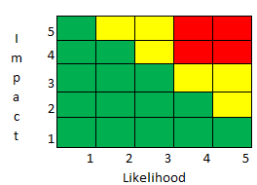
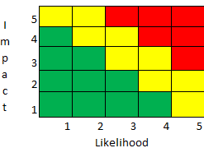
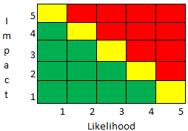
Qualitative Analysis
This helps with prioritization of risks – not all risks require an immediate response, but some will and should be watched closely
How do we assess risk?
Probability x Impact (5 * 5 grid)
Risk data quality assessment
Difference between a threat, an issue and a defect?

Slide 63
Plan Risk Response
Generally there are 4 risk responses strategies that can be used to deal with THREATS:
Avoid
Mitigate
Transfer
Accept
Key aspects of a risk response strategy:
Timely
Appropriate
collaborative

Slide 64
Plan Risk Response
 | Description of Strategy | Response
1 | Remove a work package or activity for project
2 | Notify mgmt that there could be a cost increase if a risk occurs because no action is being taken to prevent the risk
3 | Remove a troublesome resource from the project
4 | Ask the client to handle some of the work
5 | Prototype a risky piece of equipment
Avoid
Accept
Avoid
Transfer
Mitigate

Slide 65
Control Risk Plans
Happens during project execution
Based on the premise that effective risk planning has happened early in the PLC so that you are not focusing on dealing with problems but executing the risk strategies that were developed.
Some things that you are doing to monitor/control risks:
Implement workarounds
Risk Reassessment
Status Meetings

Slide 66
Question
Purchasing insurance is best considered an example of :
Mitigation
Transfer
Acceptance
Avoidance
Notes:
2 - Transfer
To mitigate we either reduce the probability of it happening or reduce its impact. Acceptance means we acknowledge its existence but do nothing to prevent it. Avoidance means we will make changes to the project schedule so that we can avoid the risk entirely.
Transference is the passing of risk onto others. It doesn’t decrease the impact, you merely transfer the risk to another party.

Slide 67
Communication Management Plan
The Comms Mgmt Plan seeks to maximize the effectiveness and efficiency of communication on the project including what should be communicated to who, when, with what method and how frequently.
Recent PMI survey of Project Managers across all industries indicated that PM’s spend 90% of their time conducting some form of communication during the execution phase of a project.
A robust comms plan is the critical interface between all stakeholders on the project and the actual project team conducting the work.
A well thought out process can shield the team from a lot of the standard status reviews, updates etc that are commonly associated with projects.

Slide 68
Types, Models, Methods
Types:
Formal written / informal written
Formal verbal / informal verbal
Models:
Three main parts – sender, message and the receiver
Encoding and decoding happens differently by people due to various factors and always as the sender had planned
Noise creeps into the comms when the decoding is not understood
Methods:
Interactive – reciprocal e.g. meetings, Lync conversations
Push – 1 way stream e.g. emailed status reports
Pull – info is placed in a central location for team to go a retrieve

Slide 69
Key Takeaways
Pre-Explore:
Charter is one of the most important docs on the project. It is your license to deploy resources in pursuit of project goals. Engage all stakeholders.
A formal approach to planning is the requirement for effective project management
Explore and Plan
Scope – collect requirements + decompose into a WBS – start your RAID log
Time – tasks, dependencies, sequence, estimate, schedule – monitor CP
Risk – identify, analyze, plan and control
Comms – clear encoding and appropriate use of method ensure the right message is decoded

